Slide 1
Unveiling Idiomatic Nuances: Leveraging BART for Proficient Representation Learning of Expressive Language
Mahir Faisal Chowdhury
Id: 19301026
Course: CSE431
Section: 1
St: Farah Binta Haque
Ra: Humaion Kabir Mehedi
‹#›

Slide 2
Paper Title:
CLCL: Non-compositional Expression Detection with Contrastive Learning and Curriculum Learning
Paper link: http://dx.doi.org/10.18653/v1/2023.acl-long.43

Slide 3
Introduction
Authors proposed a novel method specifically for non-compositional expression detection, including idiom usage recognition and metaphor detection.
The model helps to learn easy to harder expressions and which is better than all the previous models to detect these non-compositional expressions.
To detect these, requires different representations of the same expressions.
Model is created to provide better accuracy for smaller datasets.

Slide 4
Related Works
In terms of idioms recognition, due to non-compositionality and scarcity of available data resources, previous works mainly focused on designing complex architectures while ignoring the representational aspect to model non-compositionality under a limited-resource scenario.
In terms of Curriculum learning, prior works on curriculum learning on NLP, including their difficulty measurement and scheduling strategy, are mainly designed for compositional language processes

Slide 5
Methods
Framework:
Contrastive Learning
Find difference between contextualized representations of
the figurative sense and literal sense for the same expressions
By grouping creates two distinct clusters of positive and negative of same expressions.
Curriculum Learning
Difficulty Metrics
Measures the difficulty level for each training examples
Scheduling Strategy
Schedule the training examples from easy to hard to learn the model

Slide 6
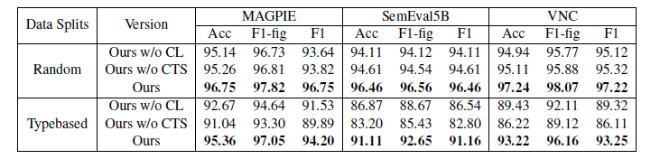
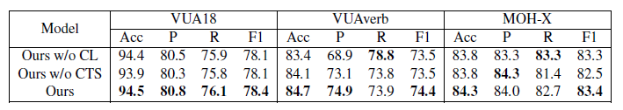
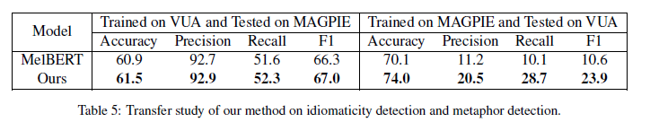
Results

Slide 7
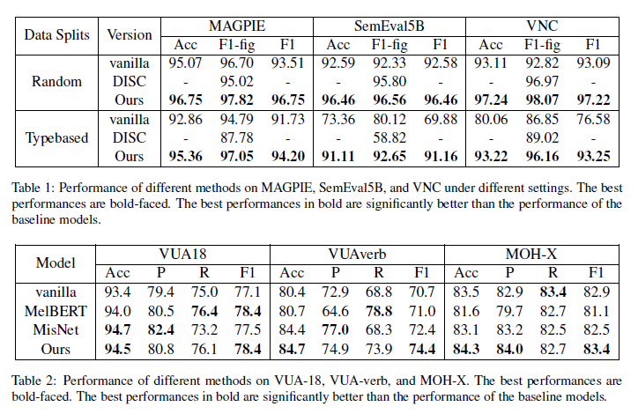
Results

Slide 8
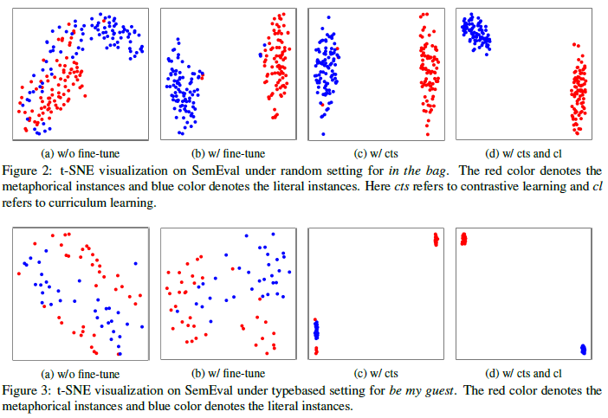
Analysis
Analysis on Datasets:
Smaller dataset gets far better results
than Larger datasets compare with
their model and baseline models
Analysis on Cross-Task Transfer
outperforms baseline model
when trained for one and tested on
other task. Idiom recognition to metaphor detection
givers better results than vise versa.

Slide 9
Future Work
Advanced methods for learning the broad nature of non-compositionality,
Like idioms and metaphors are Needed.
Solve those limitations which this model has.

Slide 10
Conclusion
Authors proposed a novel method specifically for non-compositional expression detection, including idiom usage recognition and metaphor detection.
The proposed method combines contrastive learning and curriculum learning.
The model could be trained in an easy-to-hard manner.

